Slide 1
Information System Management.
Collaboration Information Systems.

Slide 2
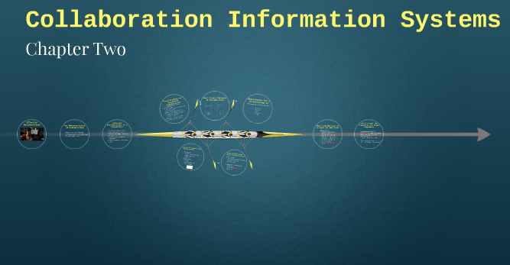
Introduction.
Collaboration IS unites entities for a common goal.
Collaboration IS defines organizational success.
Collaboration requires feedback and iteration.
Effective collaboration IS requiring technical communication tools.
Notes:
Collaboration IS has greater importance to an organization. It allows the collaborating team to give feedback in a polite way and it allows team members to learn from each other. It streamlines processes and procedures through a guideline of the essential features for an effective collaborate. It encourages enthusiasm open-mindedness, and skillful giving and receiving feedback and hence encouraging necessary actions. Collaborative IS improves the performance of those involved by enabling professionals and team members to accomplish their goals through collective decision making, problem-solving and thus creating work product (Neubert et al., 2018) Enhances growth in team capability through enhancing efficiency. Collaborative IS benefits the organization through a meaningful and satisfying experience of its employees. This cultivates professionalism and expertise in every employee’s duty and hence improving organization’s productivity.

Slide 3
Importance of collaboration information systems (IS).
Enhances effective giving of feedback.
It streamlines processes and procedures.
It improves the performance of those involved.
Enhances growth in team capability (Neubert, Ouzrout, & Bouras, 2018).
Facilitates meaningful and satisfying experience.
Notes:
Collaboration IS has greater importance to an organization. It allows the collaborating team to give feedback in a polite way and it allows team members to learn from each other. It streamlines processes and procedures through a guideline of the essential features for an effective collaborate. It encourages enthusiasm open-mindedness, and skillful giving and receiving feedback and hence encouraging necessary actions. Collaborative IS improves the performance of those involved by enabling professionals and team members to accomplish their goals through collective decision making, problem-solving and thus creating work product (Neubert et al., 2018) Enhances growth in team capability through enhancing efficiency. Collaborative IS benefits the organization through a meaningful and satisfying experience of its employees. This cultivates professionalism and expertise in every employee’s duty and hence improving organization’s productivity.

Slide 4

How collaboration tools can improve team communication.
Through creating a collaborative communication platform.
Allows giving and receiving of feedback.
Through transparency in sharing information and knowledge.
Through quick asking of questions (Neubert et al., 2018).
Through informal culture for combining skills.
Notes:
Collaborative tools create a collaborative communication platform where the team member can brainstorm together while exchanging ideas. It facilitates giving information and receiving feedback with increased accuracy. Collaboration tools allow for quick asking of questions amid the team. This creates a chance for getting a better response from the entire team through a variety of creative options. Collaboration tools encourage transparency where team members can share information and knowledge for others and hence sharing for integral efficiency and productivity (Neubert et al., 2018). Collaborative tools create an informal culture where team members can have fun while combining skills hence growing as a community, with appealing sharing of information and improved team morale.

Slide 5
Collaboration tools.
Tools for synchronous communications
  Face to face communication.
  Shared whiteboards.
  Conference calls.
Tool for Asynchronous Communications.
  Email.
  Discussion Forums.
  Skype.
Notes:
I chose these synchronous communication tools because they offer a chance for real-time collaboration, immediate responses and feedback, and that they increase social presence. Conferencing calls allow for body language and tone of voice. They increase motivation and engagement with course concepts.
I chose these asynchronous communications tools because they are readily available, they give more time for reflection, and they encourage the use of cloud technology for documentation.

Slide 6

Sharing project files and the task list for managing tasks.
Project files will be shared via email.
Task list will be shared via SharePoint.
Notes:
Email is the most convenient and accurate platform for sharing project files which include Microsoft (MS) Word, MS Excel, MS Project, and MS Visio among others. Email is universal platform ND it is accessible to every team member.
In regards to the task list for managing tasks, the SharePoint team site is essential because it links all the team members to the content, information as well as apps that we rely on a daily basis and thus it will serve as a reminder for each member about his or her task.

Slide 7
How new collaboration IS could provide competitive advantages.
Enhanced online security (Stair & Reynolds, 2017).
Stimulated partition and innovation.
More informed decision making.
Cost savings (Kavanagh & Johnson, 2017).
Notes:
Collaboration IS will pave the way for online security through research and development based on customer surveys. Collaboration tools harness the power of employees in sharing information and talking in ideal time and this will stimulate creative thoughts unlike it is the case with other organizations teams (Kavanagh & Johnson, 2017). Collaboration tools facilitates a variety of sharing and response options before coming into a final decision. Thus, the new collaboration IS will allow the team to full share information and share information about the necessary actions to take. This will facilitate the forward movement of the organization. New collaboration IS will enhance savings for the organization. The collaboration tools will help the organization to catch mistakes earlier before they occur, thus reducing the cost of time and money they could be used for revision or rectification. This will grow the firm’s capital, unlike its counterparts.

Slide 8
Conclusion.
Effective collaboration is key to success.
Collaborative IS facilitates competitive advantage for organization.
Collaborative IS will enhance organizational productivity.

Slide 9
References.
Kavanagh, M. J., & Johnson, R. D. (Eds.). (2017). Human resource information systems: Basics, applications, and future directions. Sage Publications.
Neubert, G., Ouzrout, Y., & Bouras, A. (2018). Collaboration and integration through information technologies in supply chains. arrive preprint arXiv:1811.01688.
Stair, R., & Reynolds, G. (2017). Fundamentals of information systems. Cengage Learning.

